Slide 1
UI XI
Maria Markosova

Slide 2
Last lecture
Smoothing and most probable state sequence.
Applications of filtering – Kalman filter.
Introduction to the decision theory: atomic state, lottery, utility function.

Slide 3
Outline
Simple and complex decisions.
Single and multiattribite utility function.
Monetary utility example.
Human decisions.

Slide 4
Utility functions
Single attribute, depends only on one variable , one attribute. Example : monetary utility function, in which the only attribute is the amount of money
Multi attribute, depends on many attributes, variables. Example: we want to buy a car. Our decision is influenced by the price, type, color, power …. Etc , utility function of the car has all of these attributes.

Slide 5
Single attribute utility function: monetary utility
Money: - money are used to measure the utility in economy, money are often the only attribute of the
monetary utility function.
preferency constrain: agent prefers a gain of more money (monotonous preference), but
such preference is not always the most appropriate for choosing the best possible
state.
How does monetary utility function look like?
Example: TV game – imagine, we are in a TV Millionaire game in a state we have two
possibilities to choose:
1. Take one million dollars.
2. Risk a coin toss (the coin is fair), if there is a head, we win 3 millions dollars if
the outcome is a tail 0 dollars.

Slide 6
How the average human being decides?
A lot of people, but not everybody, take a gain which is sure, that means 1 million dollars.
How the UI agent with maximal expected utility (MEU) principle implemented and will decide?
He decides to play further and toss the coin.
Why? Because the expected utility, measured by the expected amount of money tells him so.

Slide 7
(EMV – expected monetary value utility)
Expected monetary utility is better then the certain win of million dollars. If our utility function is EMW to play further and toss the coin is a rational decision .
But, we know, that to accept a lottery, because EMV suggest so, is not necessarily a good decision.
Who of you would toss the coin and play further?
Imagine you are Bill Gates? Would you toss the coin in this case?

Slide 8
TV game example: How we decide and why?
- denotes the state „I have $n“; my property in a bank is $k.
Let us calculate EU of the lottery :
We need to know

Slide 9
What is in fact more realistic monetary utility function?
Grayson (1960): Utility is proportional to the logarithm of the amount of money
U
U
Is there even more realistic utility taking into account a debt possibility?
$
$

Slide 10
What we know about our TV lottery?
In a coin toss the tail has a probability ½.
The head has the same probability ½.
Utility function according which we decide needs to take both outcomes into account.
What else to take into account? How to make a good decision?
It is necessary to take our wealth into account, because this fact influences our decision.
We know, that if an agent prefers one state before the other one, utility should prefer the same.

Slide 11
U
Let means “I have k million dollars in a bank.
The realistic monetary utility function is on Fig.
$
If we are in a quickly growing positive part , then holds
If my utility (life level) having a property k miliónov $ is evaluated by the value 5 and for k+3000000 $ by the value 10 and also for k+1000000 $ by the value 8, then we have:
and I reject the lottery.

Slide 12
U
$
2. If I am as wealthy as Bill Gates, then I am on a flat part of the monetary utility curve and I am more prone to risk, because:

Slide 13
If we have debts, we decide like this:
If we have a small debts (we are in a steep negative part of the monetary utility curve), certainity of a smaller benefit can delete our debts.
If we have a great debts (500 mil. dollars for example), we are more prone to the risk, because it is, from the utility point of view, almost the same having 499 mil. or 500 mil . dollar debth.

Slide 14
Alais paradox (Alais, 1953) and irrationality of human decision
There are two lotteries:
A: with 80 percent probability one gains 4000 dollars
B: with 100 percent probability we gain 3000 dollars
What is your intuitive decision?
0.8 x 4000=3200, is more then 3000, so for the simple expected utility function where the more money the better, A is better. But the people decide for B. People intuitively have in mind a simple utility function, utility is proportional to the amount of money.
We have another lotteries :
C: with 20 perc. prob. one gains 4000 dollars
D: with 25 perc. prob one gains 3000 dollars
What is your intuitive decision?
0.2 x 4000=800, is more then 0.25 x 3000=750, so we should decide for C. But majority of people decide for D.

Slide 15
Ellsberg paradox: gain is fixed, probability of the win is estimated.
Let us draw balls from the box not seeing the box content. There are 1/3 of red balls a 2/3 of black and yellow balls in a box. We do not know how many black and how many yellow.
Two lotteries : A: to draw a red ball means a gain of 100 dollars
B: to draw a black ball means a gain of 100 dollars
What is your intuitive decision?
Majority prefers A before B, although it is irrational, because nobody knows how many black balls are in a box.
Two lotteries : C: If I take red or yellow ball, I gain 100 dollars
D: If I take black or yellow ball I gain 100 dollars
What is your intuitive decision?
Majority prefers D before C, because D 2/3 certainity of the win.

Slide 16
Human decision
People have tendency to decide for something which is certain, or more certain (certain monetary benefit for example)
People do not trust the situations they do not have under the contoll (what if the rulette is not fair and does not roll 80 percent probability for 3000 dollar gain?):
People reduce calculations, they tend to estimate not to calculate.
Emotions are also in a play (I do not want to feel stupid not winning 4000 dollars and that is why I take 3000, because they are certain)
People have aversion to double meaning. They like more 1/3 probability of a red ball then 0 až 2/3 chance of a black ball in the Ellsberg paradox
All these are predictable irrationalities of the human behavior by which managers and manipulators like to work with.

Slide 17
Multiatribute utility functions
The city council wants to build an airport. What they take into account?
price
distance to the city
how many inhabitants will suffer by noise
how much of good soil is going to be destroyed
maybe also other attributes
Multiatribute utility function

Slide 18
- Vector of attributes
Vector of attributes with assigned values
Let attributes to be a dicrete values, and let the utility be better the higher is the attribute value.
Example:
If one of the airport attributes is AbsenceOfNoise, the locality is better if the amount of people suffering by noise is smaller, that means the amount of people having absence of noise is greater.
close to town
1/price
absence of noise

Slide 19
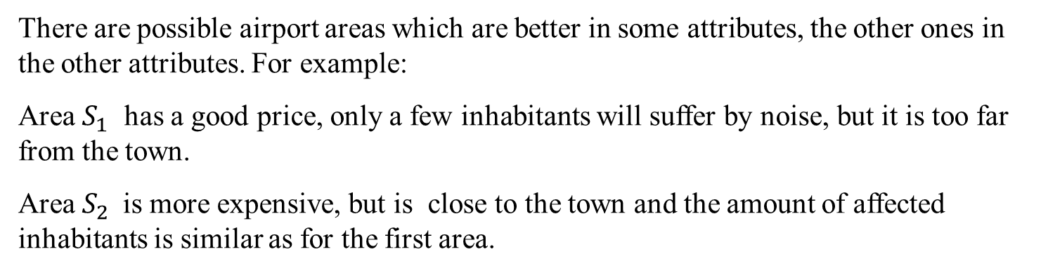
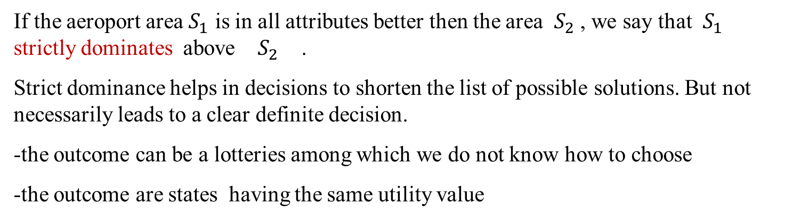
What can happen?
There are possible airport areas which are better in some attributes, the other ones in the other attributes. For example:
Area $S_{1}$ has a good price, only a few inhabitants will suffer by noise, but it is too far from the town.
Area $S_{2}$is more expensive, but is close to the town and the amount of affected inhabitants is similar as for the first area.
Strict dominance
If the aeroport area $S_{1}$ is in all attributes better then the area $S_{2}$ , we say that $S_{1}$ strictly dominates above $S_{2}$ .
Strict dominance helps in decisions to shorten the list of possible solutions. But not necessarily leads to a clear definite decision.
the outcome can be a lotteries among which we do not know how to choose
the outcome are states having the same utility value

Slide 20
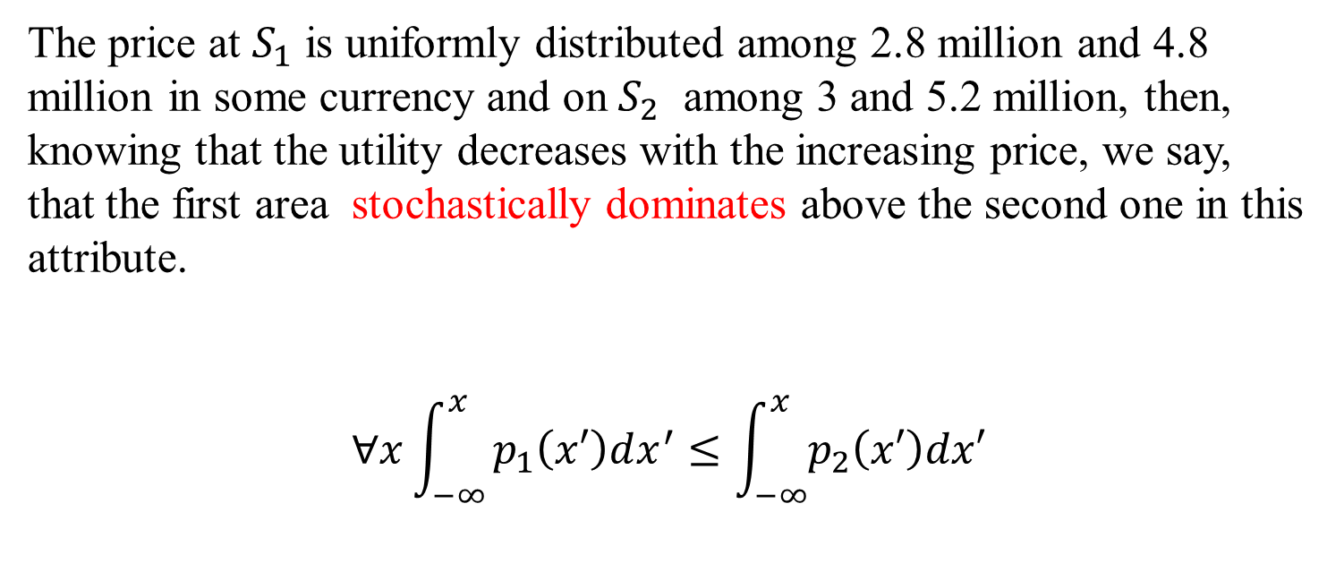
Stochastic dominance
The price at $S_{1}$ is uniformly distributed among 2.8 million and 4.8 million in some currency and on $S_{2}$ among 3 and 5.2 million, then, knowing that the utility decreases with the increasing price, we say, that the first area stochastically dominates above the second one in this attribute.
$$∀x\int_{−∞}^{x}{p_{1}\left(x′\right)dx^{′}≤\int_{−∞}^{x}{p_{2}\left(x′\right)dx′}}$$

Slide 21

Vector of attributes.
Strict dominance Stochastic dominance
B
C
B
C
A
A
D
Deterministic: B strictely dominates A. C, D do not dominate A.
Uncertain: B strictely dominates A, but not C. C stochastically dominates A.

Slide 22
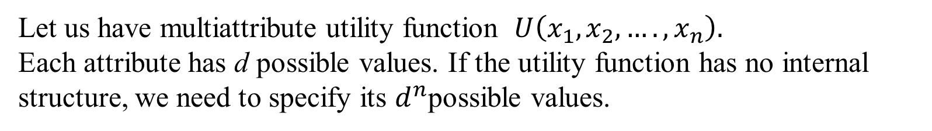
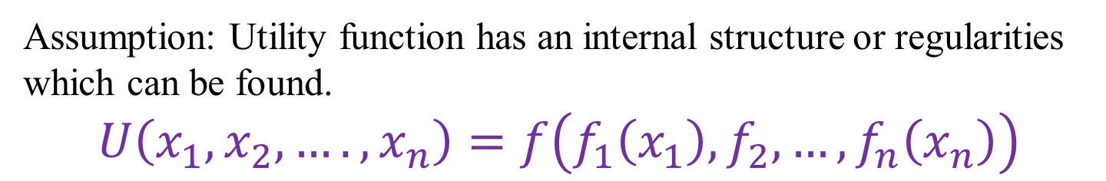
Multiatribute utility function and its preferential structure
Let us have multiattribute utility function $U\left(x_{1},x_{2},….,x_{n}\right).$ Each attribute has d possible values. If the utility function has no internal structure, we need to specify its $d^{n}$possible values.
Assumption: Utility function has an internal structure or regularities which can be found.
$$U\left(x_{1},x_{2},….,x_{n}\right)=f\left(f_{1}\left(x_{1}\right),f_{2},…,f_{n}\left(x_{n}\right)\right)$$
Example : f can be a simple function, for example a sum of the particular one attribute functions. The structure depends on the problem we look at.

Slide 23
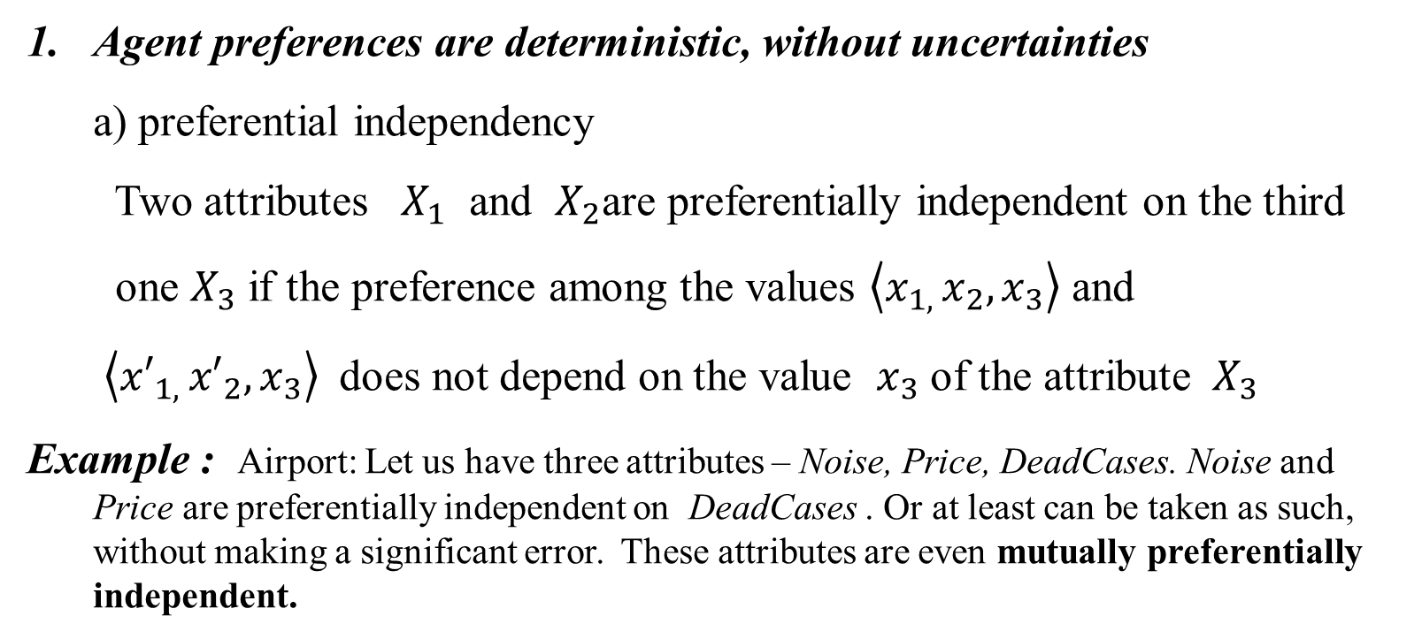
Possible regularities in the utility functions
Agent preferences are deterministic, without uncertainties
a) preferential independency
Two attributes $X_{1}$ and $X_{2}$are preferentially independent on the third
one $X_{3}$ if the preference among the values $\left\langle x_{1, }x_{2},x_{3}\right\rangle$ and
$\left\langle {x′}_{1, }{x′}_{2},x_{3}\right\rangle$does not depend on the value $x_{3}$ of the attribute $X_{3}$
Example : Airport: Let us have three attributes – Noise, Price, DeadCases. Noise and Price are preferentially independent on DeadCases . Or at least can be taken as such, without making a significant error. These attributes are even mutually preferentially independent.

Slide 24
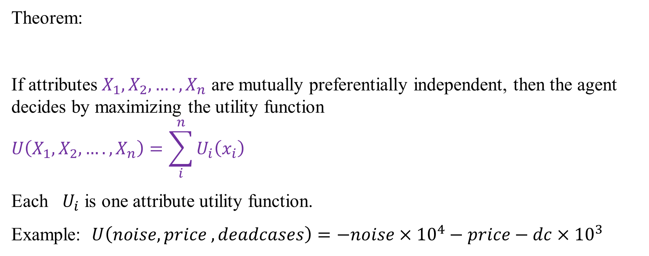
Theorem:
If attributes $X_{1},X_{2},….,X_{n}$ are mutually preferentially independent, then the agent decides by maximizing the utility function
$$U\left(X_{1},X_{2},….,X_{n}\right)=\sum_{i}^{n}{U_{i}\left(x_{i}\right)}$$
Each $U_{i}$ is one attribute utility function.
Example: $U\left(noise, price ,deadcases\right)=−noise×{10}^{4}−price−dc×{10}^{3}$
2. Nondeterministic agent’s preferences: To find a structure in the utility if we do not decide among states but among lotteries is a difficult problem.

Slide 25
Preliminary summary
Introduction to the decision theory: atomic state, lottery, utility function.
Simple decisions and single and multi attribute utility function.
Strict and stochastic dominance.

Slide 26
More complex decisions
More complex decision means, we do not decide about one best action at the current state, but about the best action sequence.
Example: What is the best sequence of actions of certain agent moving on a square lattice and doing the defined task?
If we decide about an action sequence, we are in fact planning. But we have in mind, that the environment is in general not deterministic.

Slide 27
Markov decision problem and how to find an optimal policy
Reward 100
Actions North , South, East , West.
The probability to execute an action (move in an ordered direction) is 0.8.
Reward
-100
Order N = North means :
Initial state
0.8
0.1
0.1
The result of seeking an optimal action sequence is an optimal policy, such which enables an agent to get the highest possible gain, reward, utility.

Slide 28
Reward 100
We start at the position (1,1). What is the probability to reach reward 100 exit if the orders are north,north, east, east, east?
Reward -100
1 2 3
Initial state
What is the probability to reach reward 100 exit if the orders are north, north, east, east, east randomly, if only last order is correctly executed?
1 2 3 4

Slide 29
Reward 100
Policy: Policy is a strategy which tells the agent wherever on the grid what is the best action. Best from the point of view of gaining the maximal utility.
Reward -100
1 2 3
Initial state
1 2 3 4
What is the optimal policy if the step in the environment costs nothing and an agent can make infinite number of steps (agent has infinite amount of time)? Agent wants to use 100 exit and gain thus the utility 100.
In reality if robot, agent walks in a stochastic environment, in which the action outcome is uncertain, each step costs something, and the agent can also gain something. Policy is then changed on the basis of gains and losses.

Slide 30
Utility function as a reward:
Reward 100
Reward -100
1 2 3
100, (3,4)
R(s)
Initial state
-100, (2,4)
-3, elsewhere
1 2 3 4
s is a state, small square area
Finite horizon : agent needs to solve the problem (to reach an exit 100) in a final number of steps
Infinite horizon: agent has infinite time to solve the problem, infinite number of steps
What is the optimal policy, if the agent is not penalized (step costs him 0) and has 3 steps, 100 steps available and a starting point is (1,3).
In this case policy strongly depends on the number of steps (time, finite horizon). The policy is not stationary. Policy for an infinite horizon is time (step) independent.

Slide 31

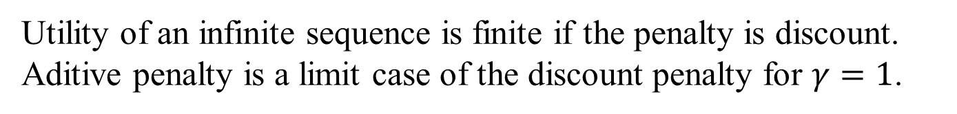
Utility of a state sequence and an infinite horizon
Additive penalty
Discount penalty
$R\left(s_{0}\right)=R\left(s_{1}\right)$=$R\left(s_{2}\right)$=…=-3
Utility of an infinite sequence is finite if the penalty is discount. Aditive penalty is a limit case of the discount penalty for $γ=1$.

Slide 32
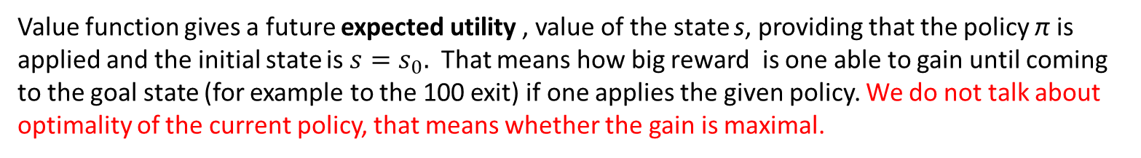
-3
-3
-3
Reward 100
Value function
-3
-3
Reward -100
1 2 3
s
-3
-3
-3
-3
1 2 3 4
Value function gives a future expected utility , value of the state s, providing that the policy π is applied and the initial state is $s=s_{0}.$ That means how big reward is one able to gain until coming to the goal state (for example to the 100 exit) if one applies the given policy. We do not talk about optimality of the current policy, that means whether the gain is maximal.

Slide 33
Value iteration algorithm and the optimal policy
VIT algorithm loos for the optimal policy maximalizing the value of the states.
Let the initial values of states are 0 and iterate
91
94
97
Reward 100
-3
-3
-3
0 0 0
88
94
Reward -100
-3
0 0 0
-3
1 2 3
May and all is deterministic, that means action is executed with 100 percent probability. What the value of the state (3,3), (2,3),(3,2) will be?
85
88
91
88
-3
-3
-3
-3
0 0 0
1 2 3 4
Because North action gives 1x0=0, West action gives -3, South the same and East gives 97. We take the one which gives the maximal value, and this action defines the actual policy for the state (3,3).

Slide 34
Stochastic case
Let the initial values of states states are 0 and iterate.
Probability of the correct action execution is 0.8
77
Reward 100
Let . . What will be the value of the states (3,3), (2,3)?
-3
-3
-3
0 0 0
-3
Reward -100
-3
48,6
1 2 3
0 0 0
0 0 0
-3
-3
-3
-3
Action East gives 0.1 x 0+0.8x(-100)+0.1x77-3. Action West gives 0.8x0+0.1x0+0.1x77-3.
As an actual policy policy action North is taken, because gives the highest value.
1 2 3 4
Action North

Slide 35
Belmann solution for the best policy
1. Initial state utility values are arbitrary.
2. Calculate the right hand side of
for each state with given initial values and find a new values of
all states. There are as many equations as states.
New state values are given to the right hand sides of the iterated equations and the policy is subsequently changing.
Repeat, while the equilibrium state is not reached, in which holds:

Slide 36
Belmann equation
Is a basis of the „value iteration“ algorithm of the MDP (markovian decision problem) solution.
If there are n possible states, we have a Bellmann equation for all of them, with n unknown values (state values).
We are solving n (nonlinear, due to the max operator) equations with n unknown values. The solutions are state utilities . The equations are solved iteratively. Due to the Belmann update the system of equations converges.

Slide 37
Policy after the convergence of the it. process
Try to find for this simple case how the policy changes with changing reward R(s) (if reward goes from negative to positive values). You may use arbitrary Belmann update from 0 to 1, because the convergence is granted. The best update is from 0.8 to 0.9, so the convergence is not that quick.
Reward 1
Reward -1
1 2 3
1 2 3 4

Slide 38
From the solution of Belmann equation for the previous problem one gets following intervals R(s) in which the policy is different.
Agent is so strongly penalized, that he goes strait to the closest exit, regardless what exit it is.
Agent seeks the shortest path to the +1 exit risking random exit through the –1 gate.
The penalization is so small, that agent does not risk at all.
Agent has profit from walking in the environment, so he does not go to the exit at all.

Slide 39
Preliminary summary
Simple decision; we deal with single attribute or multiattribute utility function.
In simple decision we look for the best possible sction.
Complex decision in deterministic environment: we look for best action sequence, giving the best expected utility.
Complex decisions in nondeterministic environment (MDP): we look for the best policy
Best policy is found with a help of Bellman equations based on the value iteration algorithm.

Slide 40
More complex games and decisions in the multiagent environment.
Minimax algorithm:
Game solving algorithm which finds the best plies from the MAX point of view, if both agents act in two agent fully observable deterministic environment. Both agents alter their moves and both play optimally (maximizing their utility).
More complex games? How to decide in a games if all agents play at once (not knowing about themselves), or they play in an environment which is not fully observable.

Slide 41
Single move game
One move game attributes:
Players, there are players . Their names start by a capital letter.
Actions. Their name starts with non capital letter.
Payoff function: Utility function giving utility of one action or of an action combination from the point of view of each player.
Strategy – pure – in a deterministic games strategy specifies unique action in
each game state, situation
- mixed – mixed strategy chooses in each game situation actions with
certain probability (lottery) e.g. if there are two possible actions,
strategy suggests this lottery :
5. Strategic profile: assigning strategies to each player in pure strategy

Slide 42
Prisonner´s dilemma
Two burglars A a B are captured in an act of crime and questioned separately. The detective suggests them both (they do not know this fact) separately : If you testify against your partner, he gets 10 years in prison and you nothing if he refuses to testify. If both of you testify against each other, you and your partner get 5 years in prison. If you both refuse to testify, both of you get 1 year in prison.
Payoff matrix (utility matrix):
A: testify
A: refuse
B: testify
PA=-5, PB=-5
PA=-10, PB=0
B: refuse
PA=0, PB=-10
PA=-1, PB=-1

Slide 43
Prisonner´s dilemma, analysis
Each player wants to gain as few as possible prison years.
A point of view analysis: If B testifies against me and I against him I gain 5 prison years (utility –
5). If I refuse, I gain 10 years. So if my opponent B testifies, the best strategy for
me is to testify too.
If B refuses to testify against me and I will testify, I gain 0 prison years. If I refuse to
testify against him, I gain 1 prison year. So also in this case the better strategy for
me is to testify.
B point of view analysis: It is the same as for A. B also finds, that to testify is the best strategy
for each A move.
To testify is the dominant strategy in this game.

Slide 44
Types of strategies
Utility (payoff) of the player i in a case of the strategic profile S.
Strong dominance of the strategy: The strategy s of the player i is strongly dominating the strategy s´ if the result (utility) given by s is better as given by s´ for an arbitrary choice of other player strategies (that means for another arbitrary strategic profile).
Weak dominance of the strategy: Strategy s of the player i is weakly dominating the strategy s´ if the result of the strategy s is better, then the one given by s´ at least for one strategic profile and is not worse for the other strategic profil.
And there exists at least one case for which

Slide 45
Rational player is a player, who chooses dominant strategy, if exists. He prefers strongly dominating strategy, is such exists.
A: testify
A: refuse
B: testify
PA=-5, PB=-5
PA=-10, PB=0
B: refuse
PA=0, PB=-10
PA=-1, PB=-1

Slide 46
Repeated game
Repeated games are games which have more then one move and in which a player have to react to the repeated moves of the opponent. Each player knows the history of the opponent moves. The players are agents and the moves are their actions.
Strategic profile for the repeated game
-assigns strategy to each player in time
-utilities (payoffs) are additive

Slide 47
Repeated Prisoner´s dilema and a cooperation development
Next moves (actions) have 100 percent probability to occur.
Let the players A a B know, that they are going to be questioned 2 times under the same circumstances. How their strategies change?
Game analysis: A: If the game finishes after the second move and in this second move I play differently then testify, I am going to be worse, because I do not have information about my opponent’s move. I will only know how he plays in the first move. But if I have a strategy for the second move, my strategy for the first move is the same, because doing the first move, I do not have an information about my opponent move at the time of the first move execution.
B: has the same analysis so (testify, testify) is a dominating strategy.
If the number of repetitions is a finite number, then the strategic profile stays the same. For the finite number of the dilemma game repetition, we cannot reach cooperation.

Slide 48
A: testify
A: refuse
And what about infinite number of repetitions? Action is executed with 100 percent probability.
B: testify
PA=-5, PB=-5
PA=-10, PB=0
B: refuse
PA=0, PB=-10
PA=-1, PB=-1
I am A and my strategy is always testify. How many prison years I get?
Analysis: If B testifies, Then I get infinite many years in prison, if B refuses, then I get zero, but B gets infinite many years. Therefore he never plays refuse . B has similar analysis.
I am A and my strategy is always to refuse. How many prison years I get?
If B always testifies, I get infinite many years, if he refuses, too.

Slide 49
What if next move occurs with the probability p. The game is still infinite.
Both A and B know, that the next move occurs with the probability p , with probability(1-p) it does not occur. Let their strategic profile is (refuse, refuse). How many prison years get A? We suppose the strategic profile does not change in time.
The same way we can calculate a payoff of the player for different strategic profiles, different combination of the strategies, providing the strategic profile does not change. .
Grim trigger strategy: I play refuse, until you do not betray me and testify. If your previous move is testify, I am going to testify in all next moves up to infinity. Let both players play GT :
Questions to solve:
a) If anybody betrays is (testify, testify) up to infinity subgame perfect equilibrium (SPE) =dominating
strategy for repetitive games. ?
b) If to the current time nobody testifies and the players played (refuse, refuse), in what
circumstances the player decides to betray the opponent and testify?
Notes:
https://www.cs.umd.edu/~nau/cmsc421/game-theory.pdf
https://www.youtube.com/watch?v=8jBouAQt9EY

Slide 50
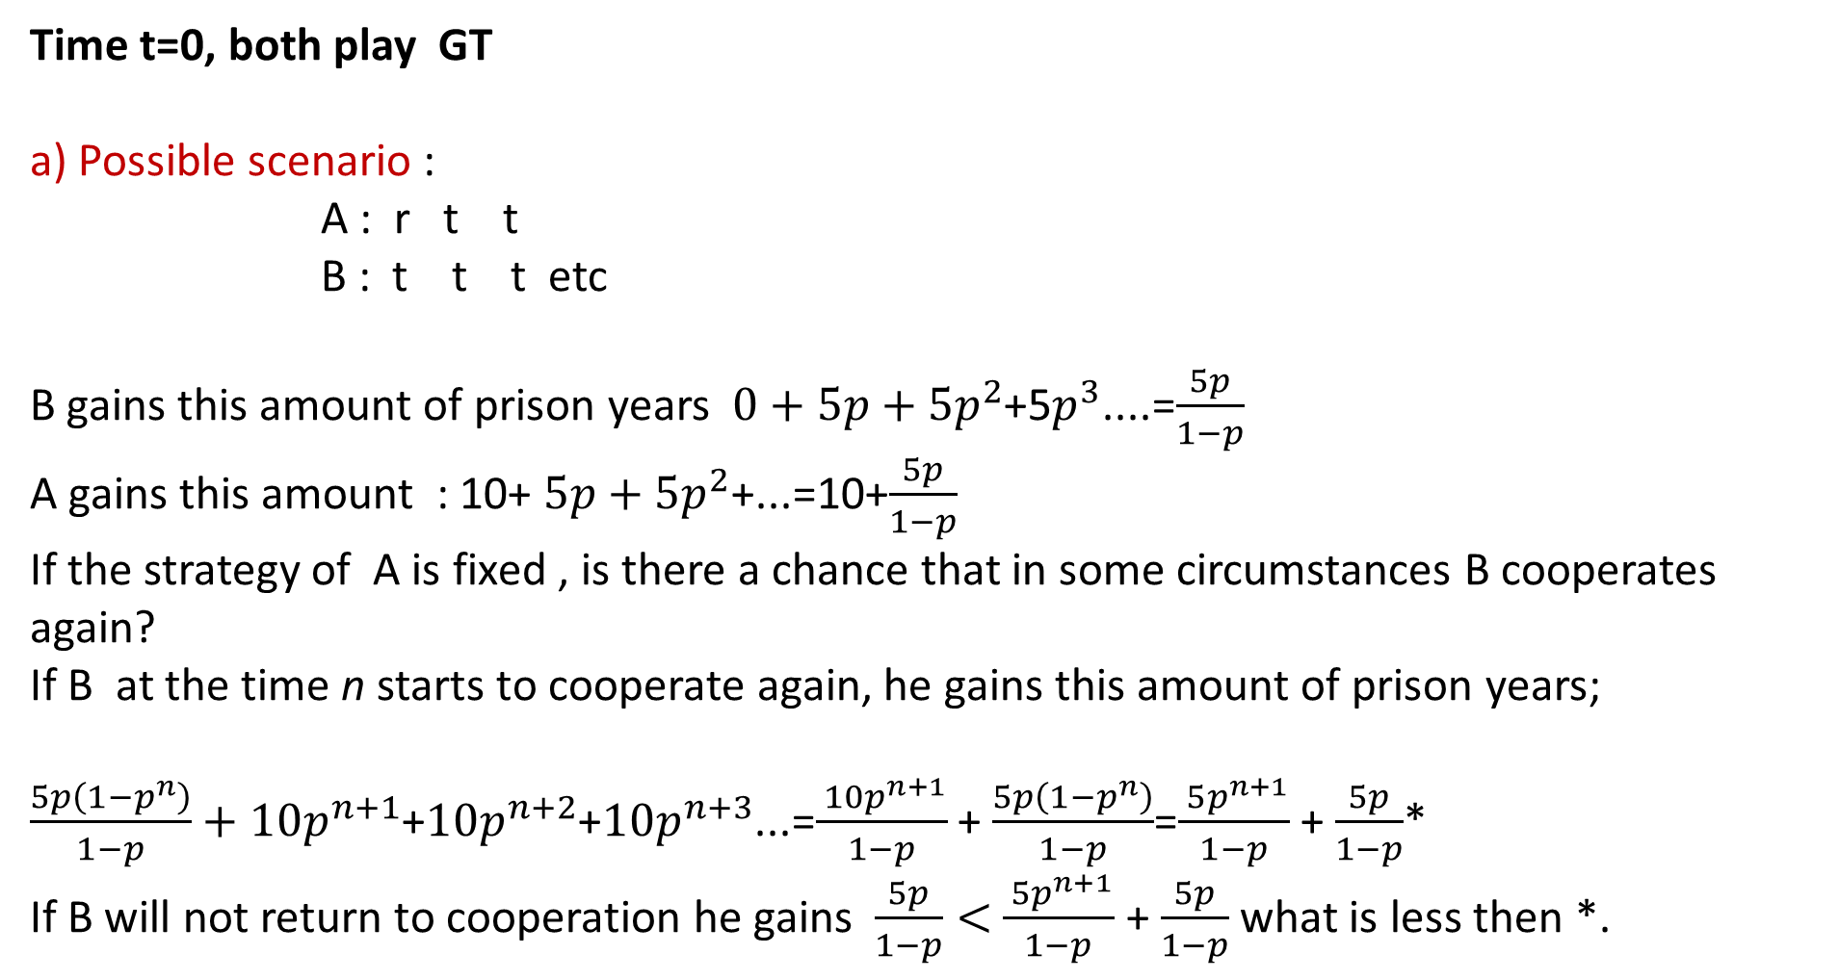
Time t=0, both play GT
a) Possible scenario :
A : r t t
B : t t t etc
B gains this amount of prison years $0+5p+5p^{2}$+5$p^{3}$....=$\frac{5p}{1−p}$
A gains this amount : 10+ $5p+5p^{2}$+...=10+$\frac{5p}{1−p}$
If the strategy of A is fixed , is there a chance that in some circumstances B cooperates again?
If B at the time n starts to cooperate again, he gains this amount of prison years;
$\frac{5p\left(1−p^{n}\right)}{1−p}+10p^{n+1}$+$10p^{n+2}$+$10p^{n+3}$...=$\frac{ 10p^{n+1}}{1−p}$ + $\frac{5p\left(1−p^{n}\right)}{1−p}$=$\frac{ 5p^{n+1}}{1−p}$ + $\frac{5p}{1−p}$*
If B will not return to cooperation he gains $\frac{5p}{1−p}<$ $\frac{ 5p^{n+1}}{1−p}$ + $\frac{5p}{1−p}$ what is less then *.
A: testify
A: refuse
B: testify
PA=-5, PB=-5
PA=-10, PB=0
B: refuse
PA=0, PB=-10
PA=-1, PB=-1

Slide 51
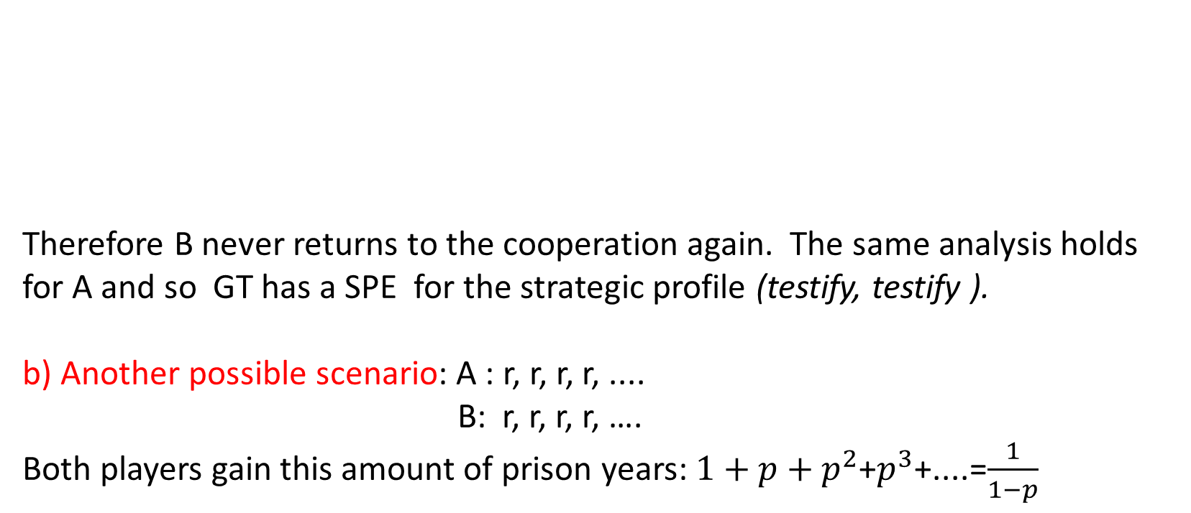
A: testify
A: refuse
Therefore B never returns to the cooperation again. The same analysis holds for A and so GT has a SPE for the strategic profile (testify, testify ).
b) Another possible scenario: A : r, r, r, r, ....
B: r, r, r, r, ….
Both players gain this amount of prison years: $1+p+p^{2}$+$p^{3}$+....=$\frac{1}{1−p}$
B: testify
PA=-5, PB=-5
PA=-10, PB=0
B: refuse
PA=0, PB=-10
PA=-1, PB=-1

Slide 52




Betrayal game . If both players play GT, then if one testifies , (testify, testify) up to the infinity is SPE.
Cooperation game. Are there any circumstances that B would like to betray (testify) at the beginning of the game? What are the circumstances in which he wants to cooperate?
If B betrays, he gains :
If not, he gains :
Cooperation is for B better if :
$$≤$$
$$≤$$
$$≤$$
$$≤$$
What if B betrays in n+1- th move?
For the first n moves both players have the same sum of payoffs for cooperation. And then the situation is as before

Slide 53

Grim trigger strategic profile has SPE (refuse, refuse), for the probabilities fulfilling this inequality ,
Where T is a payoff for the (refuse, testify) move and R a payoff for (testify, testify) move.
$$≤$$

Slide 54
Tit for tat : One player starts with refuse (cooperation), in the next moves he copies the opponent previous moves. Is there an SPE in the Tit for tat ?
t=0, both A,B play TFT
Possible TFT scenarios:
(refuse, refuse) up to infinity
A: r, r, r, r,
B: r, r, r, r
When is this scenario beneficial for a palyer?
Notes:
https://www.youtube.com/watch?v=I_Ug4vHHtGo

Slide 55
b) A in the first move plays refuse, B testify A: R T R T
B: T R T R
The first move is (refuse, testify) and then the players play TFT. We have an infinite repetition of (refuse , testify), (testify, refuse) scenario
TFT analysis: if in the first move is (refuse, refuse) the game has equilibrium strategy : A: R R R R....
B: R R R R....
Prison years for both are given by:
Notes:
https://www.youtube.com/watch?v=I_Ug4vHHtGo

Slide 56
TFT analysis: If the first move is (refuse, testify) we have : A: R T R T....
B: T R T R....
B gains this amount of prison years:
T=0, in our case of the prisoners dilemma.
B plays in a first move testify and betrays. If he plays refuse he gets 1/(1-p). He decides to betray in a first move if is beneficial for him. And it is in a case : T=0
A: testify
A: refuse
B: testify
PA=-5, PB=-5
PA=-10, PB=0
B: refuse
PA=0, PB=-10
PA=-1, PB=-1

Slide 57
If the player B plays refuse and in the n-th move he betrays (plays testify as an answer on refuse), we have a situation:
A: R .... R R T R ....
B: R .... R T R T .....
Condition, in which betrayal of B is beneficial for him is the same as before, because the first n-1 repetitions of game both have the same payoff (we analyzed this situation for G.T).
What are the conditions that one player after series of (refuse, testify), (testify, refuse) repetitions will be ready to return to the cooperation of the type (refuse, refuse) ? Only if this holds
Here T=0. But this condition is exactly opposite , to the condition when to leave the cooperation is beneficial:

Slide 58
TFT has therefore Nash equilibrium (refuse, refuse), but in general it is not SPE . SPE it is only for a game in which both conditions are valid at once, that means for p* solving the equation

Slide 59
Summary
Markov decision problem, policy, optimal policy.
Value iteration and Belman equation.
Decision in one move games. Dominant strategy, Nash equlibrium.
Decisions in the repeated games, SPE.
Grim trigger and tit for tat analysis.
Cooperation in games.

